Slide 1

Kickstarter Campaigns Analysis
Predicting Success with Machine Learning
CMPE 257
Prof Dr. Jahan Ghofraniha
San Jose State University

Slide 2
Team Members
Darshan Jani
Rohit Sharma
Charika Bansal

Slide 3


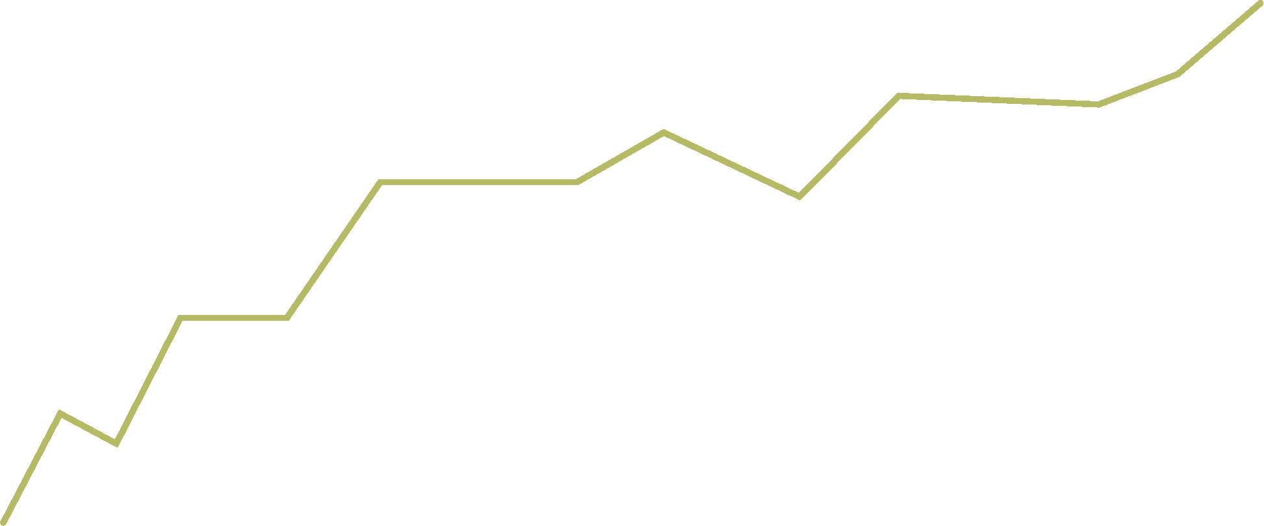
Problem Statement
Analyzing Kickstarter campaigns dataset to predict the success of a campaign using only information from project launch
Investigating the relationship between funding and GDP (Add-on)

Slide 4

Motivation
Importance of understanding factors contributing to successful crowdfunding campaigns
Analyzing GDP impact on funding to better understand the economic landscape
Improving prediction models for future campaigns

Slide 5
Dataset
Kickstarter campaigns dataset as of February 1st, 2017, containing 20,632 records with attributes such as funding goal, project name, blurb, pledged amount, backers, state, deadlines, and more
Source: Kaggle (https://www.kaggle.com/datasets/sripaadsrinivasan/kickstarter-campaigns-dataset)
Additional data: GDP for respective countries and years
Source: World Bank (https://data.worldbank.org/indicator/NY.GDP.MKTP.CD)

Slide 6
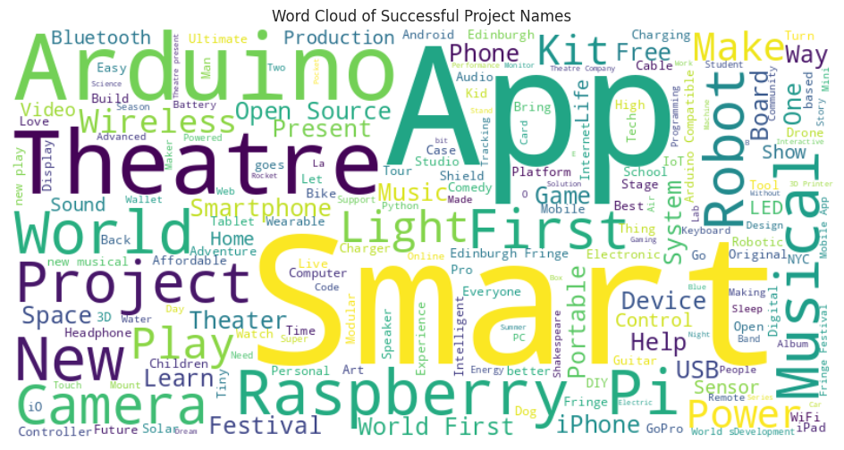

Slide 7
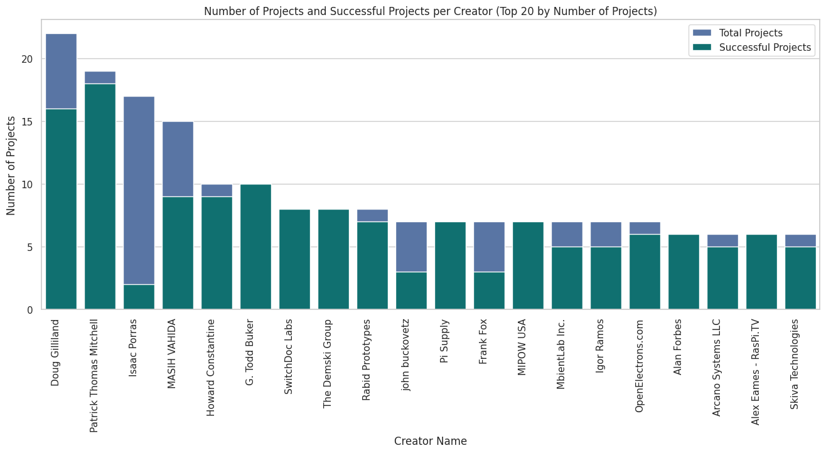

Slide 8
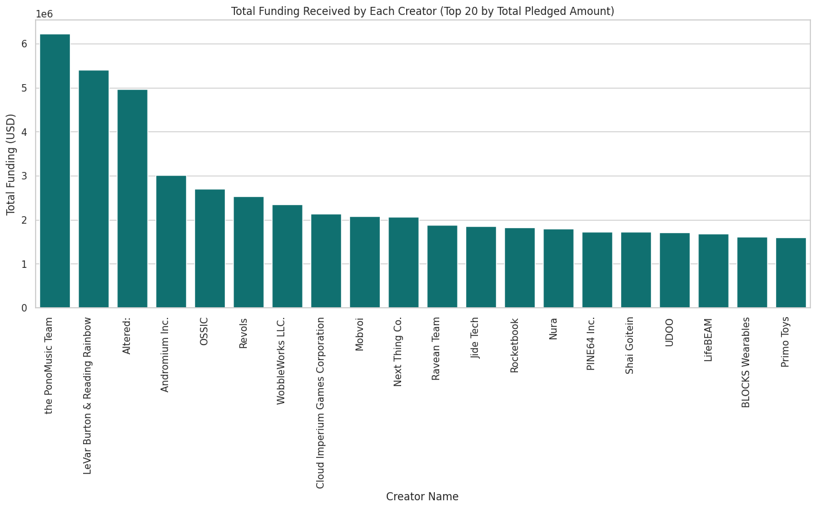

Slide 9
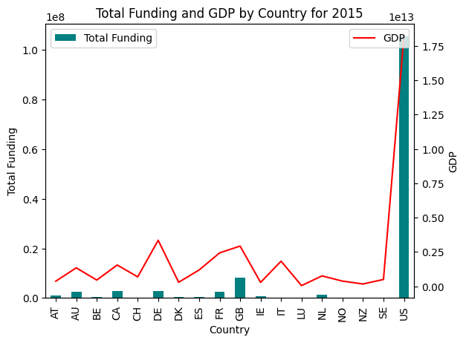
GDP vs Funding
For 2015, a bar plot of total Kickstarter funding is shown alongside a line plot of GDP (in trillions) for all countries, highlighting the relationship between each country's economic performance and crowdfunding activity.

Slide 10
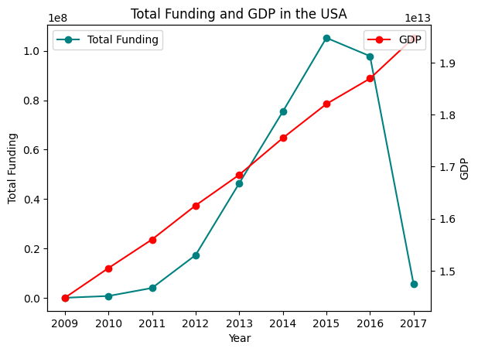
As the GDP increases, we observe a corresponding rise in the 'USD_Pledged' for Kickstarter campaigns in the USA up until 2015. However, there is a noticeable decline in the pledged amounts following 2015, despite the continued growth in GDP.
On further investigation it was found that factors like corporate changes and debt flows affected the investment stats.
Ref: https://www.federalreserve.gov/econres/notes/feds-notes/what-happened-to-foreign-direct-investment-in-the-united-states-20200213.html

Slide 11
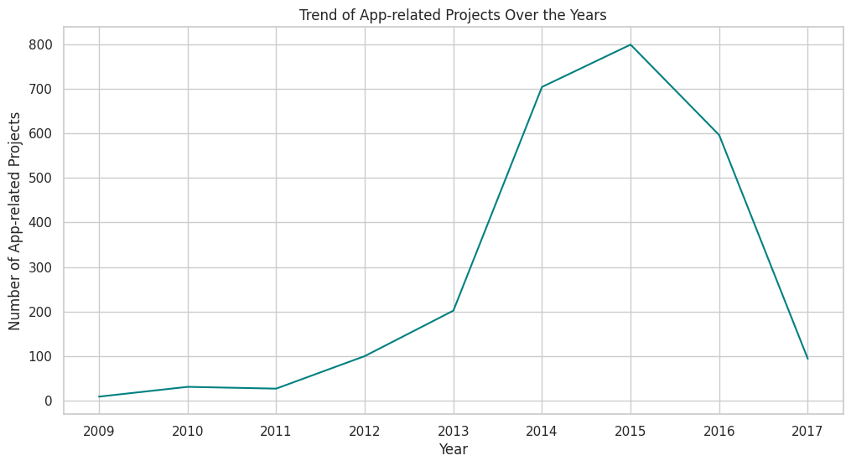
This plot reveals the trend of app-related projects over the years, with a notable rise, beginning in 2013. This aligns with the growing popularity of smartphones and mobile technology.

Slide 12
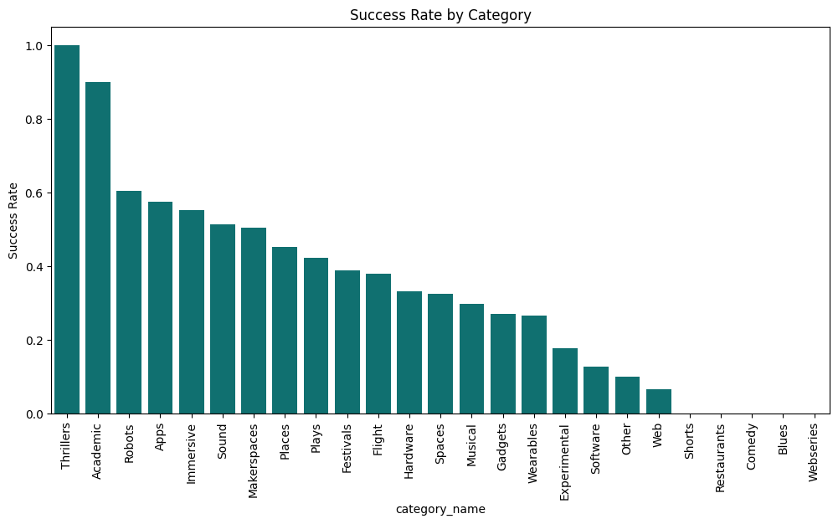

Slide 13
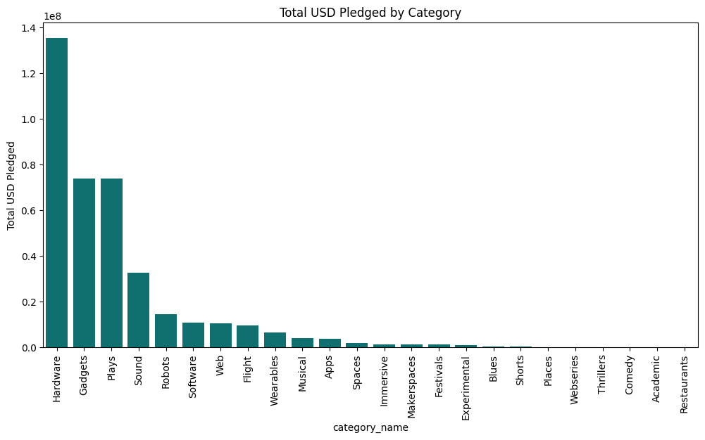

Slide 14
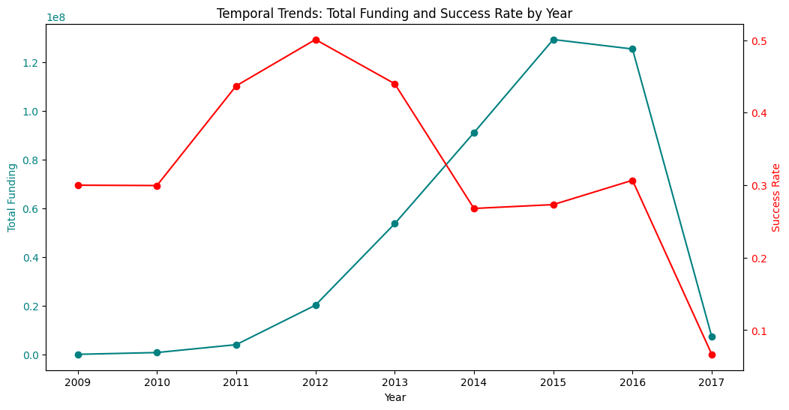

Slide 15
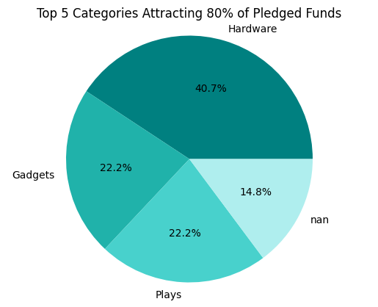
4
Sound

Slide 16
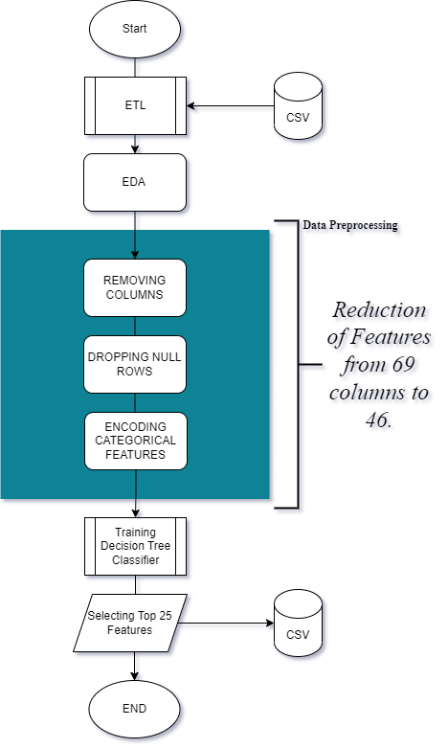
Methodology : Data pre-processing
Categorical values encoded using label and one-hot encoding
Reduced dataset from 68 features to 46 after data cleaning
Identified top 25 features using a decision tree, accounting for 98.84% of the data's importance

Slide 17
Selected Features
blurb_len | 0.0026
deadline_month | 0.0026
blurb_len_clean | 0.0025
launched_at_month | 0.0022
state_changed_at_day | 0.0022
launched_at_day | 0.0022
static_usd_rate | 0.0021
created_at_day | 0.0020
created_at_hr | 0.0020
created_at_month | 0.0020
create_to_launch_days | 0.0019
name_len | 0.0018
state_changed_at_hr | 0.0018
founder_name | 0.0018
name_len_clean | 0.0016
state_changed_at_yr | 0.0015
Deadline_yr Total Importance | 0.0014 98.84
Feature | Importance
backers_count | 0.2397
launch_to_state_change_days | 0.2004
goal | 0.1657
pledged | 0.1245
launch_to_deadline_days | 0.1051
usd_pledged | 0.0476
launched_at_yr | 0.0394
disable_communication_b | 0.0317

Slide 18


Methodology : Model Selection
Models used:
Logistic Regression
Support Vector Classifier
Decision Tree
AdaBoost
Random Forest
Bagging,
XGBoost
Rationale: Chosen models perform well with high-dimensional data
Data splitting: Stratified sampling used during train-test split to prevent skewed data
Evaluation metrics: Precision, Recall, F1-Score, and Accuracy

Slide 19
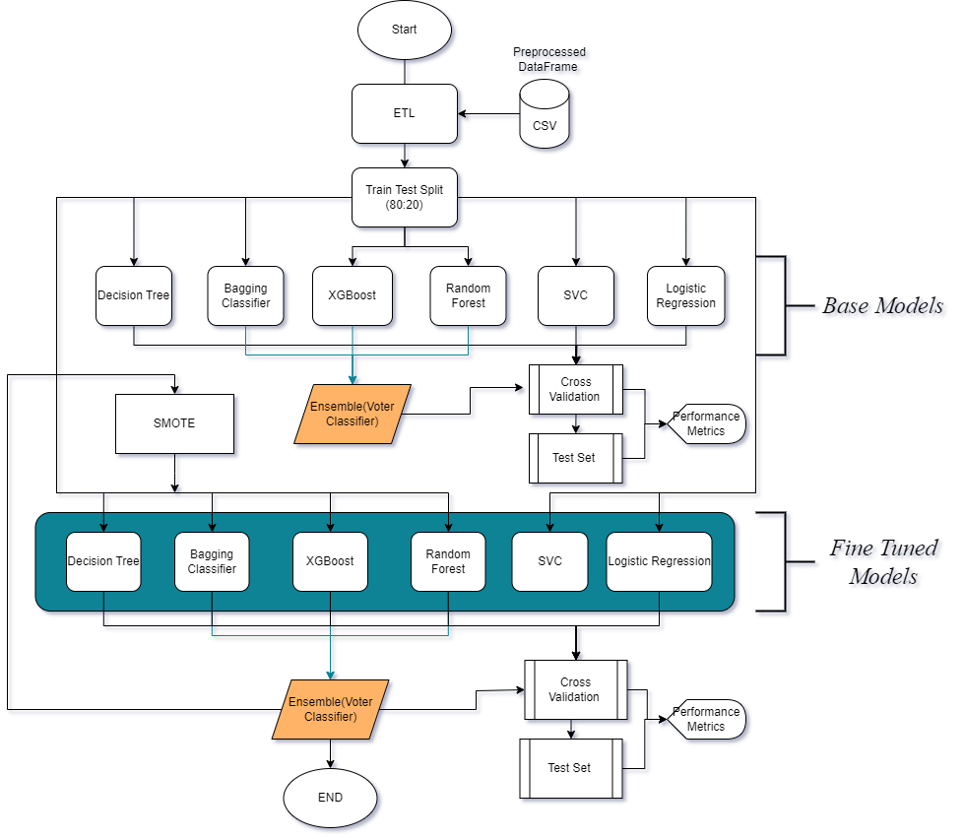

Slide 20
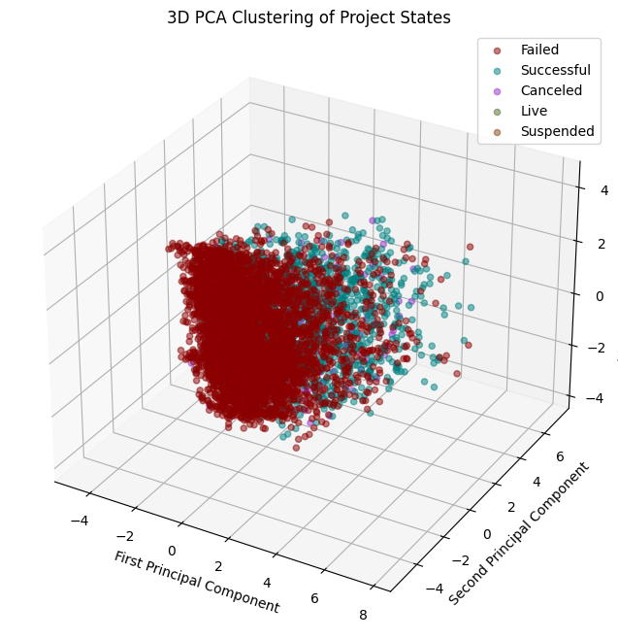
Applied PCA on top 25 features to reduce dimensionality
Extracted 3 principal components
Created a 3D scatter plot to reveal relationships and patterns in the transformed dataset

Slide 21
Results : Base Classifiers vs Fine-Tuned
Classifiers | Test Accuracy (%) | F1 Score (%) | Scaled Features (Accuracy) | Scaled Features (F1 Score)
Random Forest | 96.02 % | 95.88 % | —--- | —---
XGBoost | 98.61 % | 98.41 % | —--- | —---
Decision Tree | 95.68 % | 93.49 % | —--- | —---
Logistic Regression | 78.89 % | 34.63 % | 84.07% | 89.41%
Bagging | 97.26% | 95.58% | —--- | —---
ADABoost | 71.98% | 53.46% | —--- | —---
SVM | 64.54% | 24.95% | 78.40% | 83.92%
Classifiers | Test Accuracy (%) | F1 Score (%) | Scaled Features (Accuracy) | Scaled Features (F1 Score)
Random Forest | 97.81 % | 97.92 % | —--- | —---
XGBoost | 98.73 % | 98.74 % | —--- | —---
Decision Tree | 95.90 % | 96.25 % | —--- | —---
Logistic Regression | 80.05 % | 35.60 % | 83.78% | 89.35%
Bagging | 97.60% | 97.84% | —--- | —---
ADABoost | 96.02% | 96.43% | —--- | —---
SVM | 64.44% | 24.87% | 78.49% | 24.87%

Slide 22
Voting Classifier and Performance Metrics
Combined individual fine tuned classifiers using Voting Classifier
Enhanced model performance by taking a vote of each classifier and selecting the prediction having highest vote.
Evaluated the voterclassifier model using performance metrics:
Precision
Recall
F1-Score
Accuracy

Slide 23
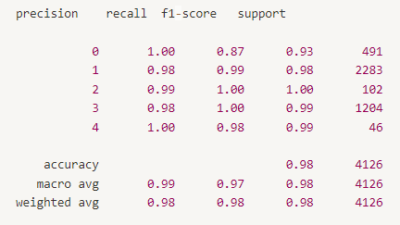
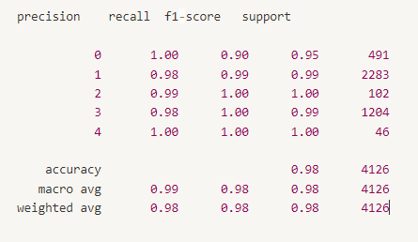
Voting Classifier and Performance Metrics
Base Model Voter Classifier
(XGB, Bagging, Random Forest)
Fine-tuned Model Voter Classifier
(XGB, Bagging, Random Forest)
Test Accuracy: 97.93%
F1 Score: 97.89%
Test Accuracy: 98.35%
F1 Score: 98.32%

Slide 24
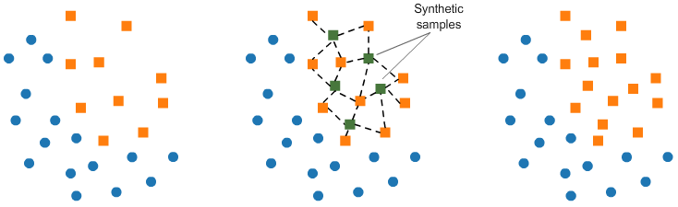
SMOTE
Classifiers | Test Accuracy (%) | F1 Score (%)
Random Forest | 97.81 % | 97.92 %
XGBoost | 98.73 % | 98.74 %
Decision Tree | 95.90 % | 96.25 %
Logistic Regression | 70.74 % | 30.53 %
Bagging | 97.60% | 97.84%
ADABoost | 96.02% | 96.43%
SVM | 64.44% | 24.87%
Classifiers with SMOTE | Test Accuracy (%) | F1 Score (%)
Random Forest | 97.96 % | 98.03 %
XGBoost | 98.44% | 98.36 %
Decision Tree | 95.68 % | 93.49 %
Logistic Regression | 78.89 % | 34.63 %
Bagging | 97.60% | 97.88%
ADABoost | 95.15% | 95.66%
SVM | 62.57% | 31.17%

Slide 25
Thank You

